Slide 1
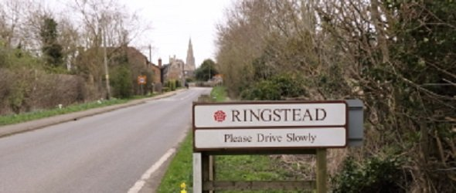
THE VIEWS OF SOME OF THE CHILDREN IN THE VILLAGE
Ringstead School

Slide 2
qqQ.1 What things do you like about Ringstead?
KID’S CLUBS
EVERYTHING BECAUSE THAT’S WHAT MAKES IT ‘OUR’ VILLAGE
THE PARK AREAS:
Peach Park
Gardens
The Rec
CHURCH
HERITAGE OF OUR VILLAGE
FRIENDLY COMMUNITY
THE DIFFERENT HOUSES
SHOPS:
VILLAGE SHOP
POST OFFICE
FISH & CHIPS
THE LAKE
THE SCHOOL

Slide 3
qqQ.2 What things don’t you like about Ringstead?
TOO MANY HOUSES
LITTER:
RUBBISH
DOG LITTER
HORSE LITTER
NOT ENOUGH CAR PARKING
NOT ENOUGH PARKS FOR CHILDREN
NARROW FOOTPATHS
TRAFFIC
AROMA FROM D & H
I LOVE EVERYTHING
NOT ENOUGH RESTAURANTS

Slide 4
qqQ.3 What changes do you want to see in Ringstead in the future?
MORE OUTDOOR & INDOOR ACTIVITIES:
FOOTBALL CLUB
RIDING STABLES
BIRD WATCHING HIDE
LIBRARY
MINI MUSEUM
MORE OPTIONS FOR EMPLOYMENT
WIDER VARIETY OF RESTAURANT’S
CAFE
MORE EQUIPMENT IN THE PEACE PARK:
ZIPLINE
SKATE PARK
MORE LITTER BINS:
RUBBISH
DOG LITTER
MORE SHOPS:
SWEET/TOY
FLORISTS
ICE CREAM
MORE HOUSES:
BIGGER HOUSES
FLATS
LEISURE ACTIVITIES:
SWIMMING POOL
GYM

